Slide 1
Talking about destitution - why narratives and framing are important
Emma Harrison, Chief Executive, IMIX
@IMIX_UK media@imix.org.uk

Slide 2
How we’ll spend our time together
An overview about what framing means & why it matters
Why we want to find different ways of talking about destitution
What we’ve done so far
How you can get involved
If you have questions, please do ask, I am here to learn from you too!

Slide 3
Where is the public at?
Immigration is something the UK public cares about
25% are migration liberals (immigration is good)
25% reject migration
50% have ,mixed views
The government (and many governments of the past) feel they need to be tough on immigration
The media is OBSESSED with immigration
Much of the discussion ignores the fact that migration is about people like you!

Slide 4
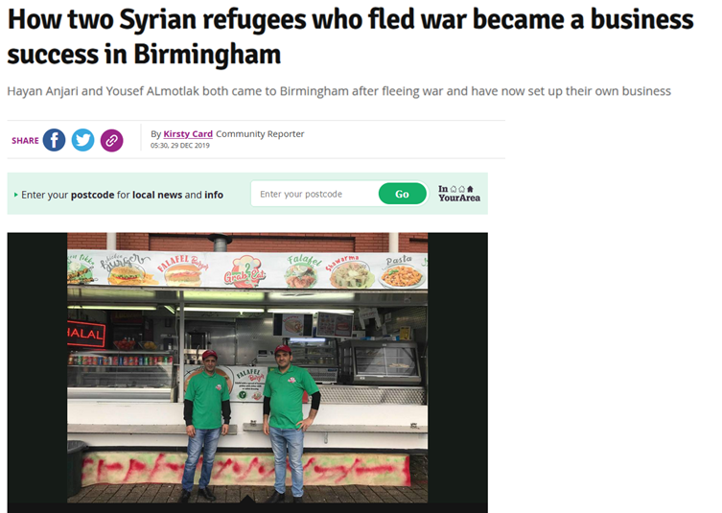
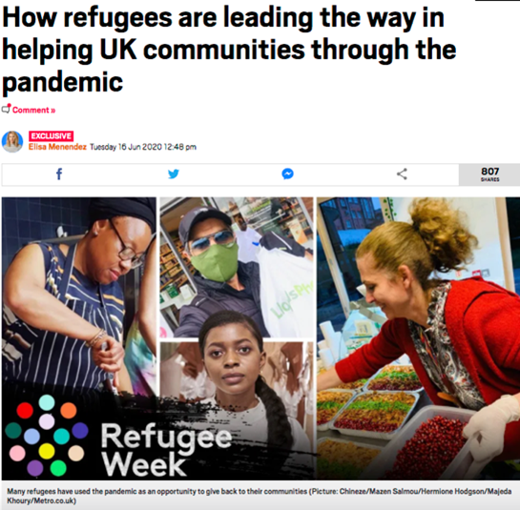
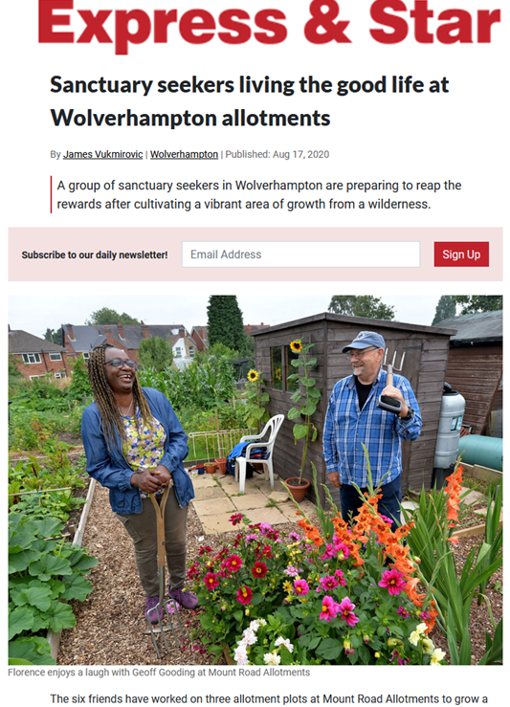
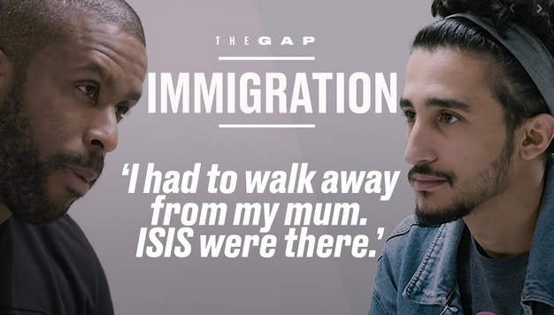
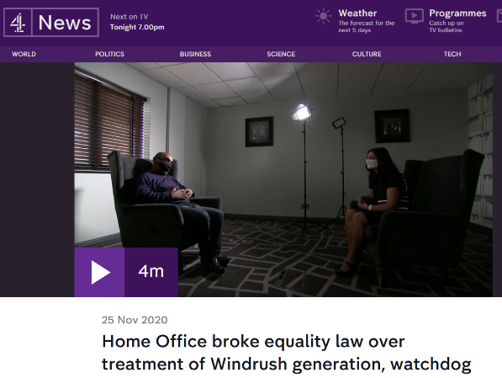
What we do

Slide 5
So what is framing?
Notes:
I

Slide 6
When we talk about framing we mean
How we talk about an issue in a certain way
The stories and histories we choose to talk about a subject
The images we use to illustrate an issue
The word and phrases we use to help people understand something they know nothing / little about
Often called ‘a narrative’

Slide 7
Why are ‘narratives’ important?
Provide a simple, engaging easy way of talking about a problem or issue
They can persuade people to be on your side
Connect with people in a different way
Help change perceptions about an issue or cause

Slide 8
Notes:
I

Slide 9
How do we create a narrative?
Understand the problem
Get to know how people are already talking about the issue and why that can be helpful or harmful
Find simple, value-based ways of talking about the problem

Slide 10
Why can’t we just talk about rights?
Rights based campaigning is vital to us all
But lots of people think rights ‘belong’ to someone else and aren’t universal
Rights are abstract to most people
Rights do not make most people tick, we need to think more about values….

Slide 11
What’s a value?!
Values are the things that you believe are important in the way you live and work. They (should) determine your priorities, and, they're probably the measures you use to tell if your life is turning out the way you want it to.
Notes:
I

Slide 12
What have we done so far?
Worked with people with lived experience to better understand
The problem
How destitution is talked about
How we’d like people to talk about the issue
Talked to lots of people about campaigning together

Slide 13
So how do you think we should we talk about destitution?
Notes:
I

Slide 14
Over to you
Create a sentence to explain destitution without using the word destitution!
Or, if that is too hard (which it probably is) come up with some words and phrases which would help a spaceman understand

Slide 15
Next steps
More research
Testing some new messages
Checking back in with our expert panel
Creating some content and packages to help communicate better

Slide 16
Any questions?

