Slide 1


Slide 2
Agenda
1pm - Registration and lunch
1.40pm- Introduction to the day and apologies (Julian Prior, Chair of Trustees)
1.45pm- Introduction and overview of NACCOM, update on the annual report and accommodation survey and Q&A (Dave Smith, NACCOM Coordinator)
2.00pm- Update on NACCOM 2020 Vision and Strategy, plans for the year ahead and Q&A (Julian Prior)
2.15pm- Report on the 2015-16 annual accounts and Q&A (Paul Catterall, NACCOM Trustee- Treasurer and Secretary)
2.30pm- Report on communications, media and advocacy, plans for the year ahead and Q&A (Lucy Smith, Communications, Media and Advocacy Worker)
2.45pm- Update on membership and Q&A (Dave Smith) followed by a short break
3.00pm- Presentations from NACCOM Members
3.45pm- Election of Board of Trustees

Slide 3
Overview of NACCOM
Update on the Annual Report and Accommodation Survey

Slide 4
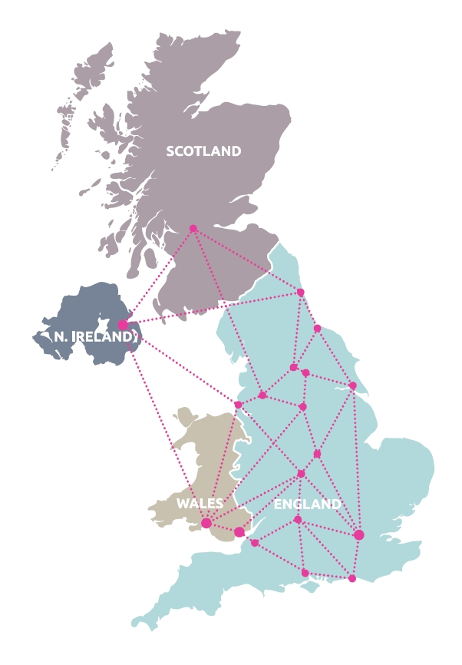
2006- NACCOM started with three projects at the first meeting
2016- 39 Full Members and 6 Associate Members
Working across 33 towns and cities in Scotland, Wales, Northern Ireland and England.

Slide 5
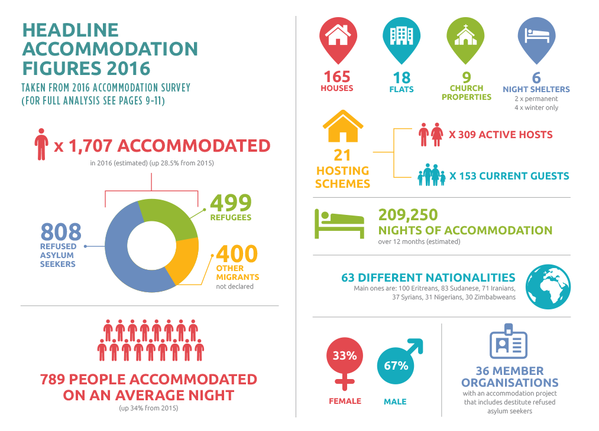
2016 Mapping Report

Slide 7
Update on NACCOM 2020 Vision and Strategy
Plans for the year ahead

Slide 8
Vision
NACCOM is committed to bringing an end to destitution amongst asylum seekers, refugees and migrants with no recourse to public funds living in the UK.

Slide 9
Mission
NACCOM exists to promote best practice in and support the establishment of accommodation projects that reduce destitution amongst asylum seekers. In addition, they may also support migrants with no recourse to public funds (NRPF) and / or refugees facing barriers to accessing affordable housing.

Slide 10
It does this by:
- providing networking opportunities to encourage, empower and connect members
- sharing knowledge and promoting best practice to provide pathways out of destitution
- working with others (including those with lived experience) to raise awareness of destitution and campaign for a just and humane asylum system
- gathering and disseminating data on the scale of destitution and positive outcomes achieved by members

Slide 11
Objectives 2017-2020
Enable members’ capacity to increase in order to accommodate more clients and encourage growth of NACCOM membership particularly in dispersal areas where there are no NACCOM members.
We aim for members to be collectively housing 1,000 refused asylum seekers a year who have no recourse to public funds (NRPF) by 2020 and a total of 2,250 homeless asylum seekers, refugees and other migrants with NRPF a year.

Slide 12
Objectives 2017-2020
Develop support to member organisations, to become more sustainable and professional, by encouraging and sharing good practice as well as promoting and supporting partnership working.
Improve data gathering from members to provide key stakeholders, influencers and decision makers with information that highlights the extent and effects of destitution, as well as the success of NACCOM members in achieving routes out of destitution

Slide 13
Objectives 2017-2020
Empowering members’ clients to tell their story so that, working in partnership with other organisations, the human face of destitution has a raised profile

Slide 14
Activities
Supporting the set-up of new / small projects or organisations to increase provision of bed spaces and support for asylum seekers and migrants with NRPF.
Identifying and promoting good practice standards across the NACCOM membership, by producing and sharing resources, including via the member’s area on the website, and running training and capacity building events for member organisations

Slide 15
Activities
Supporting members to gather data on the extent of destitution and on their work.
Commissioning evaluation, advice or other work for the benefit of member organisations and their clients
Running networking events i.e. annual UK national conference as well as regional focus group meetings

Slide 16
Activities
Developing and implementing a communications strategy to promote the work of NACCOM and its members, disseminate case studies and good practice
Building relationships with sympathetic funders/social investors to channel capacity into NACCOM and its members
Engaging with strategic partners and networks (such as the Strategic Alliance for Migrant Destitution) to ensure collaborative working where appropriate and shared learning across the wider homeless and refugee / migrant sectors.

Slide 17
2017 events and activities
February – Legal support workshop
March – Action Group weekend away and data collection
April – Fundraising conference
May – Annual report survey and gathering case studies
June – Refugee week activities
July - Hosting conference
August - Greenbelt
Sept – National conference and AGM (annual report)

Slide 18
Current priorities
Deliver current programme
Strengthen our governance
Increase staffing capacity
Develop a fundraising strategy
Become more strategic without losing our core values

Slide 19
Report on the 2015-16 Annual Accounts

Slide 22
Report on communications, media and advocacy work over the last year

Slide 23
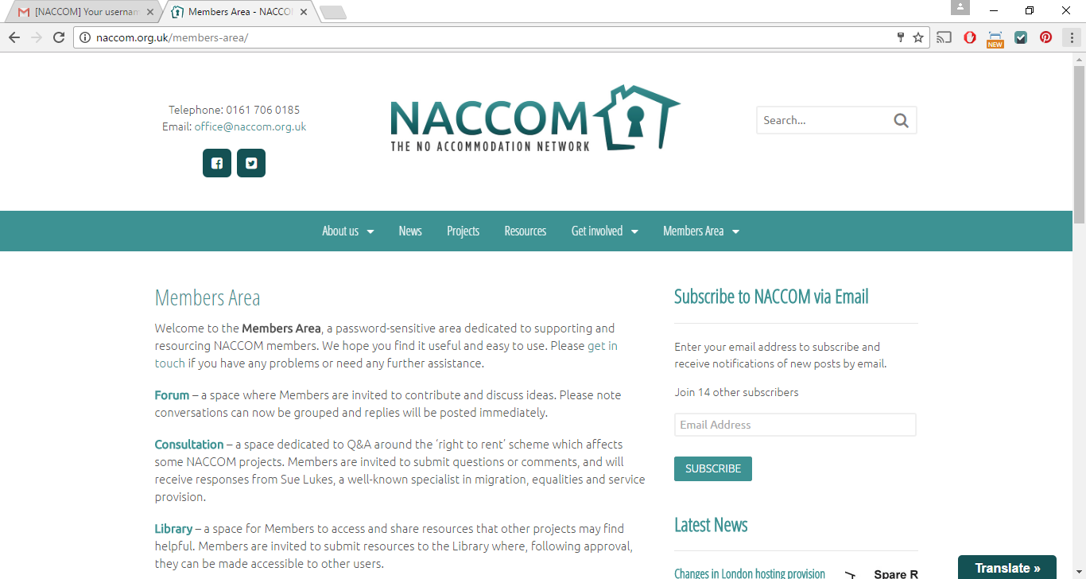
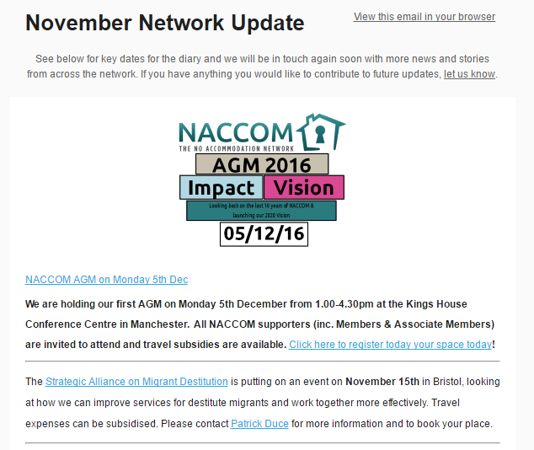
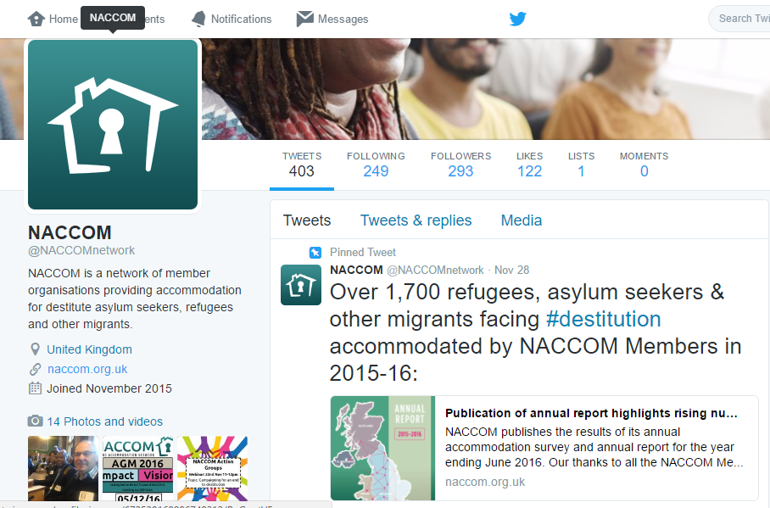
Communications

Slide 24
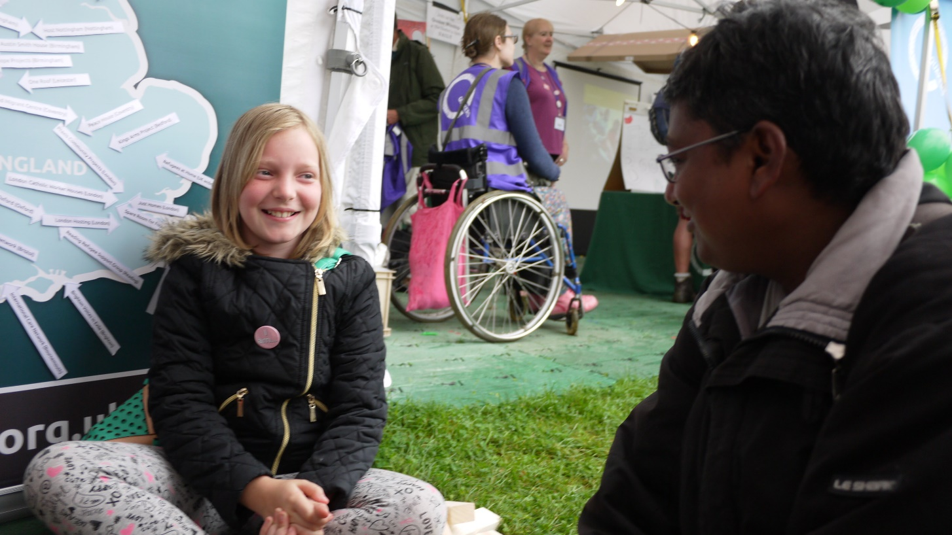
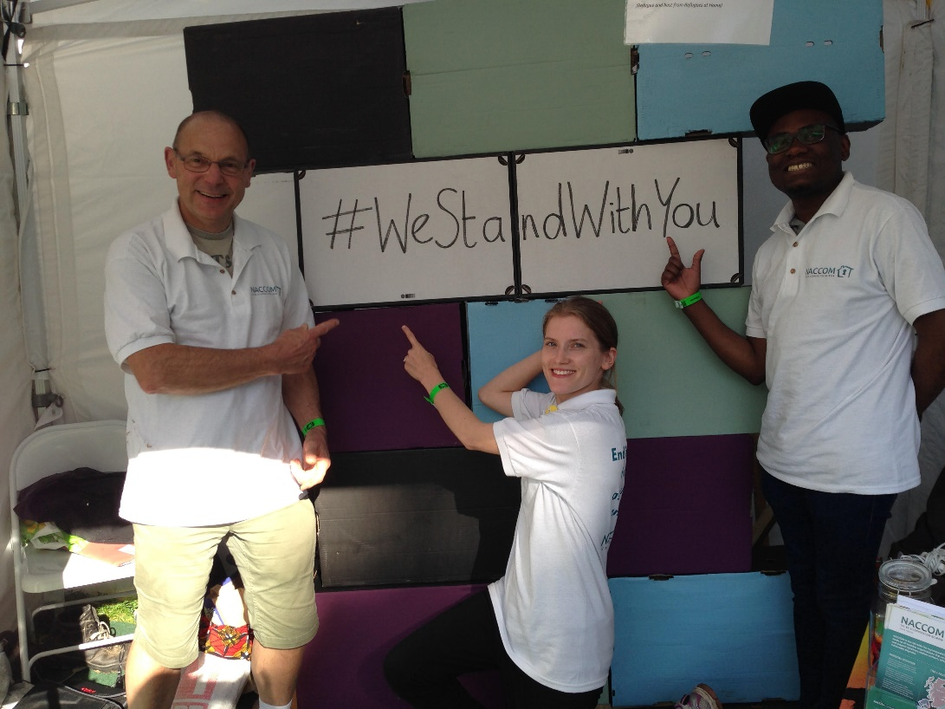
And Dave attended 20 events elsewhere around the UK too!
Greenbelt Festival

Slide 25
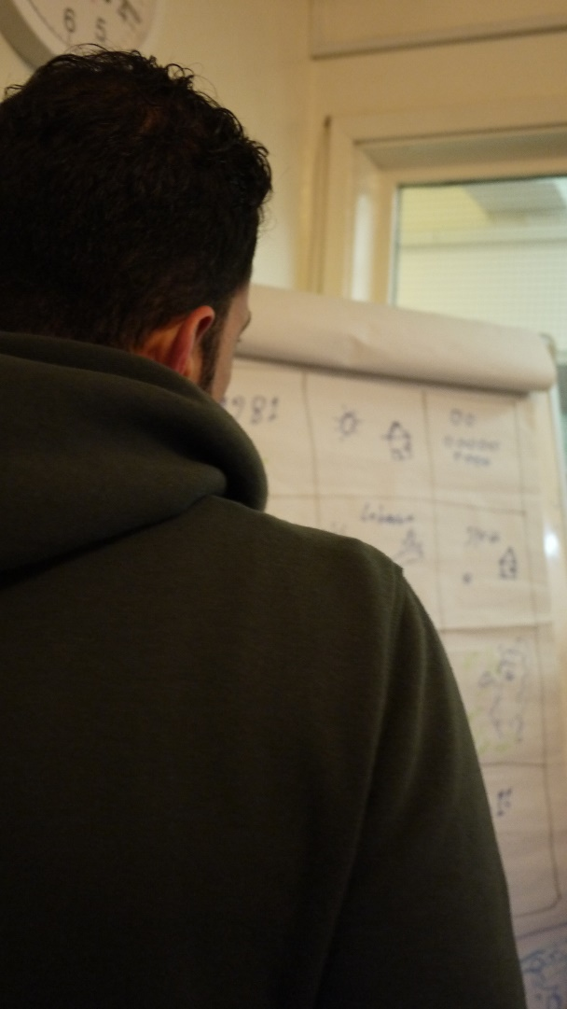
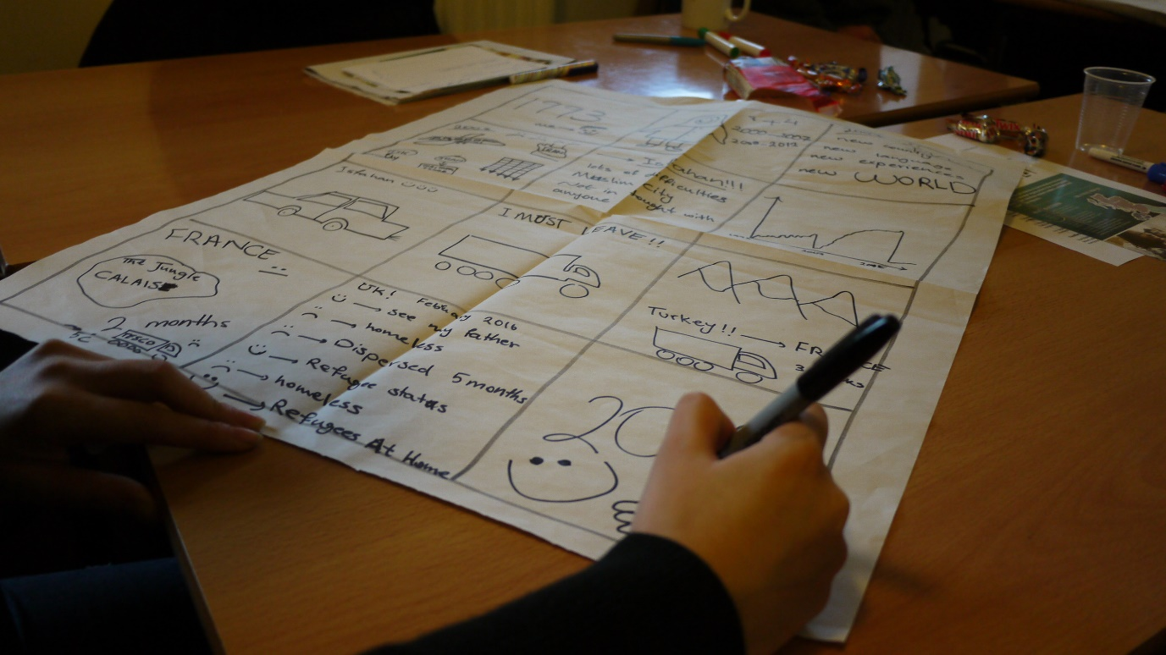
Media Training and Support
Storytelling sessions in London and Sheffield
‘when you hear other difficult story you feel there are people same as you’

Slide 26
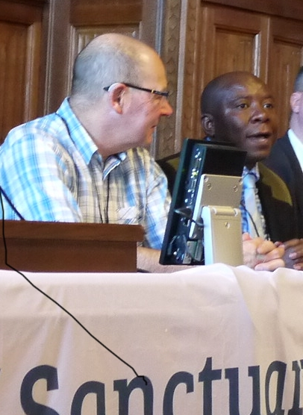
Advocacy
APPG Submission: Refugees Welcome?
Working with Still Human Still Here to find case studies of poor health as a result of low levels of support
Sanctuary in Parliament 29th Nov

Slide 27

Advocacy opportunities
JCWI survey for landlords and tenants affected by Right to Rent
Deadline 31st Dec
Action Groups- Advisors and Activists
Action Groups
Weekend away on 4-5th March 2017
Webinar due to be rescheduled – sign up to the Action Group for full details

Slide 28
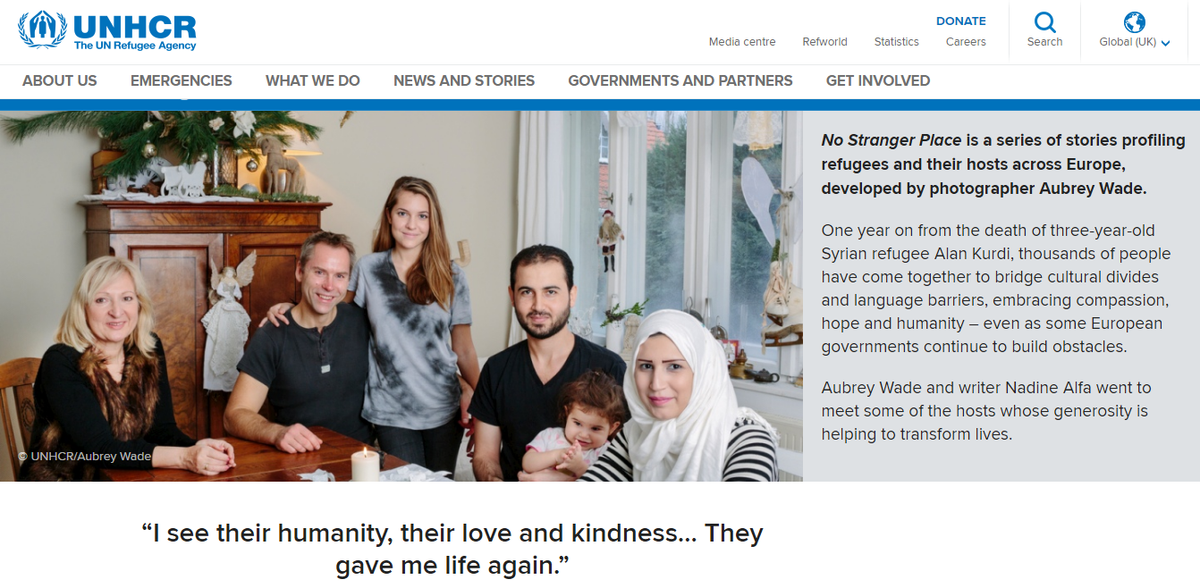
Media opportunities
UNHCR looking for hosts and refugees to share experiences for a UK version of the ‘No Stranger Place’...
Hosting documentary enquiries
Developing links with national communications/media hub iMix

Slide 29
Update on Membership
Welcome to new members! Bolton City of Sanctuary and Warm Hut are the latest to join the network.
Membership Renewal- reminders will come out soon
New process for Membership applications in 2017- to be confirmed by trustees shortly

