Slide 1
Asylum, the Media and Other Stories
Lucy Smith
Communications, Media and Advocacy Worker
NACCOM Network

Slide 2
How did we get here?

Slide 3
How did we get here?
Unprecedented requests from media outlets that charities often didn’t previously have relationships with.
Enormous levels of interest and support from members of the public.
Stories of human kindness
Stories of human tragedy

Slide 4
Where are we now?

Slide 5
What do recent trends in media interest show?
The image on previous slide is of Muhammed and his hosts Jack and Yoshiko in Leeds, and was taken from an article published at the beginning of September called ‘Refugees Welcome’ (7711 shares and 758 comments).
Helen Pidd, the journalist who wrote the article, then went on in January to become a host, and her article on this ‘Would he disapprove of my heathen lifestyle?’ has seen 100,709 shares and 1,619 comments.
To put these numbers in context, this is an image of a 2010 article on the Boaz Trust hosting scheme which was featured in the Guardian. The online version of the article had 5 shares and 42 comments.
The Daily Mail featured a comment article about the Dubs Amendment and the need for the UK to take more unaccompanied children. This had 1,200 shares and 1,600 comments.

Slide 6
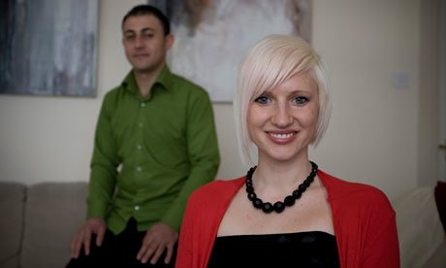
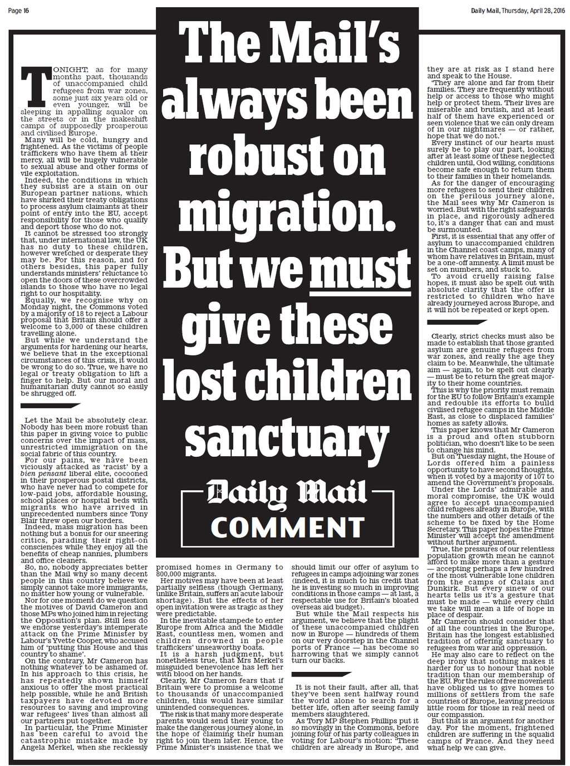

Slide 7
What next?

Slide 8
SWOT analysis exercise
STRENGTHS- what is your organisation’s USP? What are you known for doing well? Do you have any volunteers or beneficiaries who are really good at speaking and want to do this already? When has media engagement gone well?
WEAKNESSES- what do you find more difficult? When has media engagement not gone well?
OPPORTUNITIES- is there training you can access? Are there groups doing what you want to do already e.g. within NACCOM that you can learn from? What is coming up locally/nationally that you could input into?
THREATS- what will be the consequences of media engagement? What are the risks to other aspects of the organisation e.g. capacity?

Slide 9
The climate- creativity or criticism?
There are significant opportunities with the media in this current climate, more so than perhaps ever before.
But think about what are the stories that could be shared, but aren’t at the moment? How can we help to change the conversation, away from ’victimising or villainising’ to showing balance and positivity?
In the words of Chimamanda Ngozi Adichie, ‘Who are the storytellers at the moment? What stories are being told? How many stories? Where are the stories being told? To whom are the stories being told?’

Slide 10
Media tips
Press releases- keep minimal (preferably 1 page), include pictures if you can (in a separate attachment), have the details of the people that are going to be available to speak (and preferably someone that the journalist may know already- particularly relevant if local).
Interviews- get as much info as you can ahead of the event e.g. what questions will be asked, how long it will take. Get mobile numbers of people so you can call them if there’s a problem. Be clear on what is/isn’t acceptable, try to get this in writing if possible i.e. on email, to serve as a written agreement.
Decide who is (are) the best spokesperson(s) from the organisation. Send someone along with the service user if they’re the one being interviewed and make sure it is very clear what service users are/are not willing to speak about or how anonymised they want to be.
Debrief with interviewees afterwards.
Ask to see the copy before it goes to the editor to check (note this is often not possible but worth asking especially if for a sensitive piece).
Create a database of people who have said they’d be willing to speak to media. Add this as a question on hosting/volunteering forms so the idea is out there from the outset.
View your media engagement as part of a bigger picture- e.g. campaigning and advocacy for individual rights, for the organisation and for NACCOM.
If you can’t or don’t want to take the media opportunity but think it could be a good contact to keep, pass it on to NACCOM to disseminate amongst other network members.

Slide 11
Other resources to access:
Victims and villains- Migrant Voices in the British Media
Chimamanda Ngozi Adichie - The Danger of the Single Story

Slide 12
Contact details:
comms@naccom.org.uk
0161 7060185
@NACCOMNetwork
Facebook.com/Naccomnetwork

